Slide 1
Developing teachers’ knowledge and skills

Slide 2
Teacher Development
The Teacher Framework

Slide 3
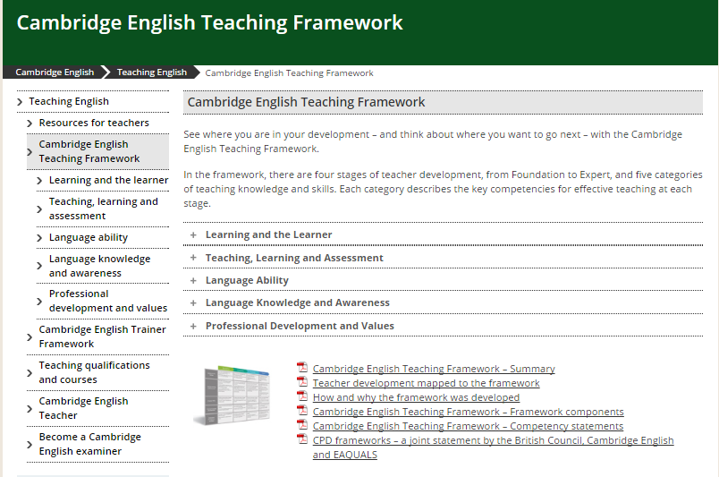
The Cambridge English Teaching Framework
www.cambridgeenglish.org/teaching-english/cambridge-english-teaching-framework/

Slide 4
The Cambridge English Teaching Framework
Notes:
We’ve produced a teaching framework which is organised according to 4 stages of competency for teachers at different stages in their development from Foundation; Developing; Proficient; Expert. And 5 categories
there are a series of competence descriptors/statements for each stage and category so that we can describe teacher competence across the development stages and the categories.

Slide 5
http://tracker.cambridgeenglish.org
Notes:
we’ve also produced The Teacher Development Tracker which is a practical user-friendly self-assessment tool to help teachers place themselves on the framework

Slide 6
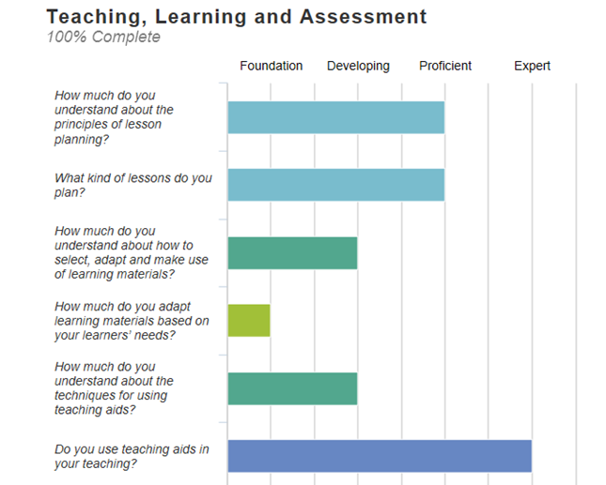
Profiles

Slide 7
Teacher Development
The Digital Framework for teachers
Notes:
Hot news!!

Slide 8
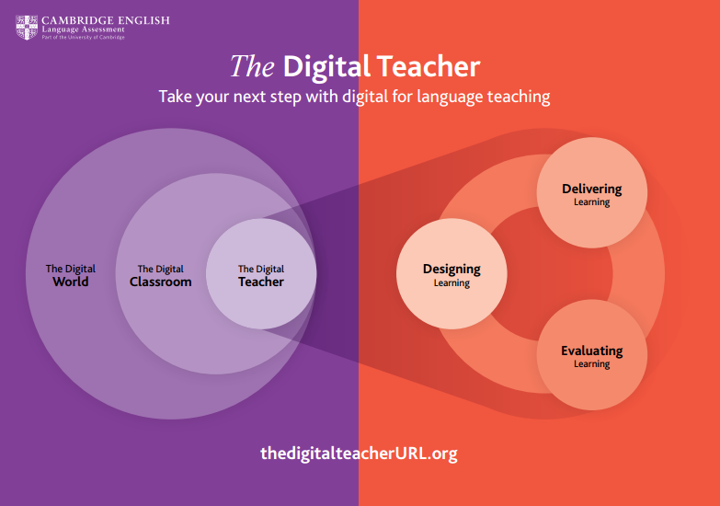
thedigitalteacher.com
Notes:
The Cambridge English Digital Framework
The Cambridge English Digital Framework has been developed in consultation with practising language teachers and trainers. It describes key competencies for teaching effectively with technology.
Explore the six categories and test your digital skills to find your starting point, and decide on a direction for your digital professional development.

Slide 9
Knowledge, Skills & Tools
Training
for each component
Recognition for training

Slide 10
The Cambridge English digital framework for teachers

Slide 11
https://thedigitalteacher.com/framework

Slide 12
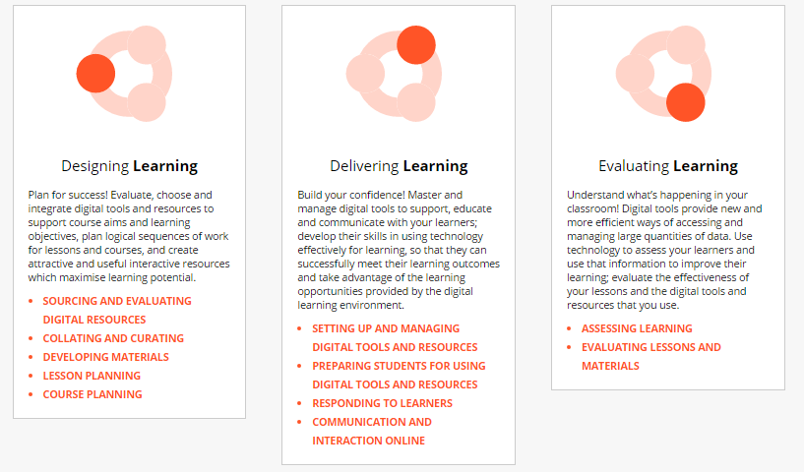
The framework

Slide 13
The framework

Slide 14
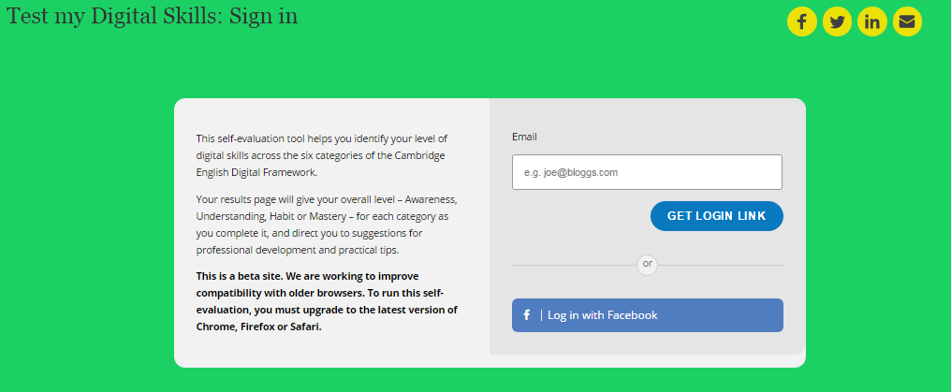
Assess your level

Slide 15
Assess your level Setting up & managing f2f learning
Awareness
I have a basic ability to deliver lessons which use digital tools (e.g. IWB, projector)
Understanding
I can deliver lessons that use digital tools and resources and I generally have no problem as long as things work as expected
Habit
I regularly do tech run-throughs before using new digital tools and resources
I have backup plans for when there are problems with technology
Mastery
I consistently deliver slick and well-executed lessons containing digital tools and resources
I help other teachers set up and deliver digital aspects of their lessons in a comfortable and effective way

Slide 16
Assess your level Setting up & managing f2f learning
Awareness
I have a basic ability to deliver lessons which use digital tools (e.g. IWB, projector)
Understanding
I can deliver lessons that use digital tools and resources and I generally have no problem as long as things work as expected
Habit
I regularly do tech run-throughs before using new digital tools and resources
I have backup plans for when there are problems with technology
Mastery
I consistently deliver slick and well-executed lessons containing digital tools and resources
I help other teachers set up and deliver digital aspects of their lessons in a comfortable and effective way
Notes:
Ask the participants to decide where they are now in this category

Slide 17
Courses

Slide 18
MOOCs
www.futurelearn.com/partners/cambridge-english

Slide 19
MOOCs
MOOCs

Slide 20
Support for teachers

Slide 21
Free teacher resources
Teaching English
Support preparing for exams
Professional development
Teaching qualifications
Newsletters
Network of Schools
cambridgeenglish.org/teaching-english
Notes:
For mobile and computer

Slide 22
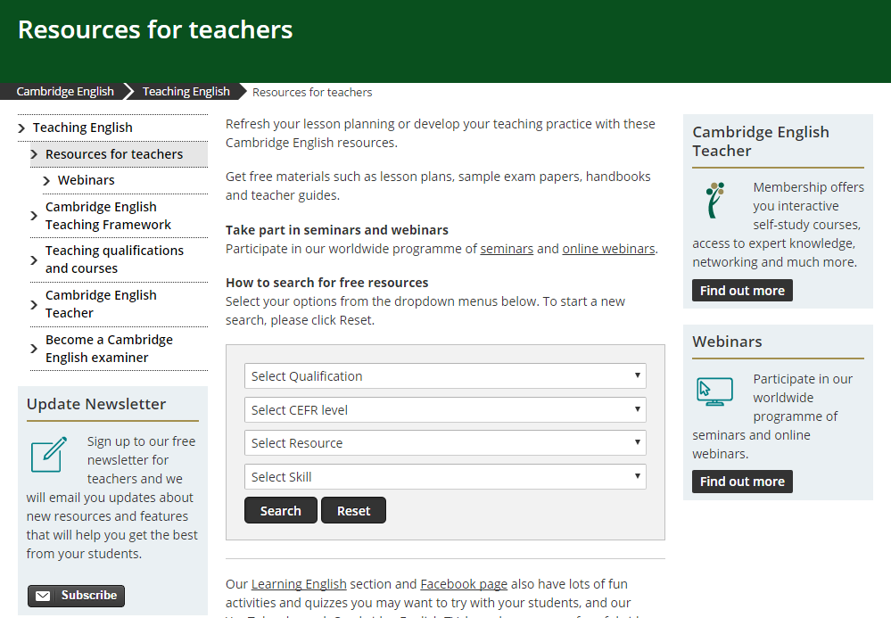
Teacher resources
Search by qualification / CEFR level / Language skill
Handbooks for teachers
Sample papers
Lesson plans
Classroom activities
Video
Vocabulary lists
cambridgeenglish.org/teaching-english/resources-for-teachers

Slide 23
Language Development
Methodology Training
Benchmarking
Cambridge English Placement Test
Monitoring and Evaluation
Train the Trainer
Language for Teaching A2
Language for Teaching B1
CELT-P
Language for Teaching B2
CELT-S
Advanced and Specialist programmes: e.g. ICELT, CLIL, EMI
Cambridge English: First
Impact Study

Slide 24
Language for Teaching

Slide 25
Language for Teaching
English language development for teachers of English and teachers of other subjects in English
In-service training
For teachers in primary and secondary education
Notes:
Our Language for Teaching courses have been developed as in-service training courses for English teachers working in primary and secondary education – and so meet the need for language ability training.
They are B2B products, so not for sale to individual teachers, only to institutions.
The minimum order of courses is 100 licences.

Slide 26
Language for Teaching
The English teachers need in the classroom
Courses start from A1 English proficiency
Even teachers with lower English level can use English in the classroom
Flexibility – online study and blended options
Allow teachers to access methodology training, e.g. CELT-P and CELT-S
Notes:
More benefits:
Even if teachers’ English is at the lower end of the scale – e.g. A2 – they can still learn the language they need to make English the main language of the classroom

Slide 27
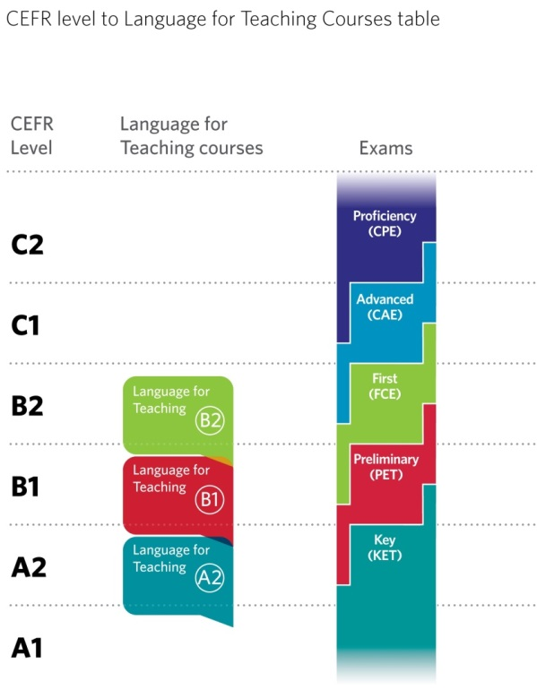
Language for Teaching
Courses take teachers from:
- A1 to A2 (Key)
- A2 to B1 (Preliminary)
- B1 to B2 (First)
100% online or blended learning
120 hours online + up to 45 hours face-to-face
Notes:
Courses at 3 levels, taking teachers from A1 to B2 level. In most cases, we’d recommend some face-to-face learning to complement and extend the online course. This would be in addition to the 120 hours. We would provide the materials for these, and also a Train the Trainer course to support local delivery and at the same time help develop a group of skilled trainers for the institution.
There are short, optional modules to prepare for the relevant Cambridge exams.

Slide 29
CELT-P and CELT-S
New qualifications for English teachers in primary and secondary compulsory education:
Better classroom teaching can lead to improved student performance
Refresh and develop teachers’ knowledge and skills – building motivation
Build on and enhance existing practice
Notes:
Main benefits of the quals:
improving learning outcomes for students is the ultimate aim – this training and qualifications can help
Motivation is another big issue – training and development can help
For existing teachers – extending their skills

Slide 30
CELT-P and CELT-S
Practical – focus on developing practical classroom skills
Scalable – online study can reach large groups
Sustainable – develop local trainers’ skills to train teachers
Accessible – courses at B1 level, so can be accessed by most teachers
Flexible – online and blended learning options; flexible part-time schedules
Notes:
Features and selling points:
Practical – these aren’t theoretical courses, they focus on actual classroom practice (supported by theory)
Scalable – the online study model makes them affordable and easy to deliver to large numbers (assuming reasonable internet access)
Accessible – at B1 language level, so teachers don’t need to be highly proficient to benefit from the training
Flexible – programmes can be tailored to the needs of the client. They can be online only, or blended with face-to-face study

Slide 31
CELT-P

Slide 32
CELT-P
Practical, communicative focus on primary English teaching context
Designed to meet the needs of English teachers in primary education
Online / blended study
120 hours online input, and assessment, + 27 hours of face-to-face training
B1 and above language level
Notes:
CELT-P will follow the same format as CELT-S, but material is different – writte specifically for the primary context – 6 – 11 year-olds.

Slide 33
CELT-P
Content:
9 Modules of study:
Module 1 – The young learner, language and the primary classroom
Module 2 – Developing listening and speaking skills in the primary classroom
Module 3 – Developing reading and writing skills in the primary classroom
Module 4 – Developing language use in the primary classroom
Notes:
Content – the 9 modules of study in CELT-P

Slide 34
CELT-P
9 Modules of study (cont’d.):
Module 5 – Managing the primary classroom
Module 6 – Planning language learning in the primary classroom
Module 7 – Resources for primary young learners
Module 8 – Assessing language learning in the primary context
Module 9 – Language awareness for teaching

Slide 35
CELT-P
Assessment:
To gain the CELT-P qualification, teachers successfully complete:
Portfolio tasks
(at the end of each Module; assessed as satisfactorily completed / not completed)
Written assessment
(TKT: Young Learners)
Assessed teaching practice
(2 developmental observations, and 1 assessed observation of teaching practice)
Grades:
Pass
Pass with Merit
Notes:
Assessment: written assessment will be TKT: YL; assessed TP will be newly developed for CELT-P.

Slide 36
CELT-S

Slide 37
CELT-S
Practical, communicative focus on secondary English teaching context
Designed to meet the needs of English teachers in secondary education
Online / blended study
120 hours online input, and assessment, + 24 hours of face-to-face training
B1 and above language level
Notes:
CELT-P will follow the same format as CELT-S, but material is different – writte specifically for the primary context – 6 – 11 year-olds.

Slide 38
CELT-S
Content:
8 Modules of study:
Module 1 – Classroom management in the secondary classroom
Module 2 – Language learning and the teenage learner
Module 3 – Teaching language skills (reading, writing, listening and speaking)
Module 4 – Language awareness for teaching
Notes:
Content – the 8 modules of study in CELT-S

Slide 39
CELT-S
8 Modules of study (cont’d.):
Module 5 – Teaching language (grammar, lexis and phonology)
Module 6 – Planning language learning (lessons and courses)
Module 7 – Language learning resources and materials
Module 8 – Assessing language learning

Slide 40
CELT-S
Assessment:
To gain the CELT-S qualification, teachers successfully complete:
Portfolio tasks
(at the end of each Module; assessed as satisfactorily completed / not completed)
Written assessment
(TKT: Module 1)
Assessed teaching practice
(2 developmental observations, and 1 assessed observation of teaching practice)
Grades:
Pass
Pass with Merit
Notes:
Assessment: written assessment will be TKT: YL; assessed TP will be newly developed for CELT-P.

Slide 41
CELT-S
Notes:
The following slides give some examples from the CELT-S course.
This is the introduction page to Unit 7, which looks t using coursebooks. You can see the simple navigation – the course is on Moodle, which is an easy to use platform.

Slide 42
CELT-S
Notes:
This is an example activity – candidates listen to teachers talking and select topics discussed.

Slide 43
CELT-S
Notes:
Theory to Practice sections at the end of each unit ask teachers to relate what they’ve studied to their own situation.

Slide 44
CELT-S
Notes:
When teachers submit their answers, they’re given further advice and comments.

Slide 45
CELT-S
Notes:
The feedback and advice from the previous slide.

Slide 46
CELT-S
Notes:
Each unit ends with a short test of the input in that unit.

Slide 47
CELT-S and CELT-P
Developing English language teachers’ knowledge and skills
Help improve student learning
Build teachers’ skills and confidence
Practical – develop classroom skills
Scalable – reach large numbers of teachers
Sustainable – supported by local trainers
Accessible – at B1 level
Flexible – online or blended learning
Notes:
Run through a quick summary of the key sales messages

Slide 48
Train the Trainer

Slide 49
Train the Trainer
Build sustainability by developing a local team of skilled trainers
Delivered face-to-face by an experienced Lead Trainer
30 hours, usually full-time over 5 days, plus induction day and online standardisation
Local trainers deliver face-to-face training and assess Portfolio Tasks and Teaching Practice
Notes:
We’re developing a Train the Trainer programme. This will serve two purposes: 1. where the institution running CELT-P and CELT-S can and wants to, we can train their trainers to deliver the face-to-face components of programmes and standardise them to deliver the TP assessment. 2. it will help develop a group of skilled trainers for the institution.
Each institution using the courses will need to have a local administrator, who can set up courses and add the teachers to them, as well as being able to track progress, set deadlines, and generate certificates of completion. We’ll provide training for this person.

Slide 50
Train the Trainer
Content:
6 Modules of study:
Module 1 – The training class
Module 2 – Analysing and designing training sessions
Module 3 – Delivering training sessions
Module 4 – Observing teachers
Module 5 – Managing feedback
Module 6 – Course planning and trainer development
Notes:
We’re developing a Train the Trainer programme. This will serve two purposes: 1. where the institution running CELT-P and CELT-S can and wants to, we can train their trainers to deliver the face-to-face components of programmes and standardise them to deliver the TP assessment. 2. it will help develop a group of skilled trainers for the institution.
Each institution using the courses will need to have a local administrator, who can set up courses and add the teachers to them, as well as being able to track progress, set deadlines, and generate certificates of completion. We’ll provide training for this person.

Slide 51
Train the Trainer
Process:
Submit applications for Lead Trainers – usually highly experienced tutors on CELTA, ICELT or Delta
Submit nominations for course participants. Minimum requirements:
B2 / C1 English (essential)
At least 5 years relevant English teaching experience (essential)
Experience of delivering training sessions (desirable)
Experience of observing teachers and giving feedback (desirable)
Notes:
We’re developing a Train the Trainer programme. This will serve two purposes: 1. where the institution running CELT-P and CELT-S can and wants to, we can train their trainers to deliver the face-to-face components of programmes and standardise them to deliver the TP assessment. 2. it will help develop a group of skilled trainers for the institution.
Each institution using the courses will need to have a local administrator, who can set up courses and add the teachers to them, as well as being able to track progress, set deadlines, and generate certificates of completion. We’ll provide training for this person.

Slide 52
Local Course Administrator
Local Course Administrator (LCA) role:
Support users on the platform
Main point of contact with Cambridge English support
Monitor participation and progress against schedules
Arrange scheduling and logistics of face-to-face training and of assessments
Check on submission of tasks, reports etc.
Training for the LCA is by webinar. LCAs need:
B1 or higher English
Reasonable IT skills
Notes:
We’re developing a Train the Trainer programme. This will serve two purposes: 1. where the institution running CELT-P and CELT-S can and wants to, we can train their trainers to deliver the face-to-face components of programmes and standardise them to deliver the TP assessment. 2. it will help develop a group of skilled trainers for the institution.
Each institution using the courses will need to have a local administrator, who can set up courses and add the teachers to them, as well as being able to track progress, set deadlines, and generate certificates of completion. We’ll provide training for this person.

Slide 53
Certificate in EMI Skills

Slide 54
Certificate in EMI Skills
For academic staff in Higher Education Institutions whose first language is not English
Helps improve teaching quality
Supports internationalisation
Notes:
The key messages about the course: it can help improve the quality of teaching where subjects are taught in English; it supports higher education institutions that are aiming to internationalise, by teaching subjects in English, attracting overseas students, and raise their rankings

Slide 55
Certificate in EMI Skills
Academic staff will:
Be able to use English more effectively
Improve skills in delivering instruction in English
Learn a variety of language options for different teaching situations
Notes:
The benefits for the teaching staff: many academic teaching staff receive little or no training in their roles before they start, and in these situations are often asked to teach their subjects in English with very little experience or support. This course exposes them to a range of styles of lectures etc., so they can improve their teaching style generally while focusing on the English skills they need, and learning a variety of language options to use in their teaching.

Slide 56
Notes:
This is the introductory unit, looking at lecture styles. You can see the simple navigation on the left of the screen (the courses are in Moodle – an easy platform to use) which shows the elements of the unit.

Slide 57
Certificate in EMI Skills
Practical – focus on developing practical teaching skills in English
Scalable – online study can reach larger groups
Accessible – courses at B1 and above level, so accessible to most teaching staff
Flexible – online and blended learning options, and flexible schedules
Notes:
Selling points: key points are practical, scalable, accessible and flexible.
Practical – these aren’t theoretical courses, they focus on actual classroom practice (supported by theory)
Scalable – the online study model makes them affordable and easy to deliver to large numbers (assuming reasonable internet access)
Accessible – at B1 language level, so teachers don’t need to be highly proficient to benefit from the training
Flexible – programmes can be tailored to the needs of the client. They can be online only, or blended with face-to-face study

Slide 58
Certificate in EMI Skills
Engaging content
Notes:
The course uses a range of input covering different academic subjects – in this case looking at visual aids for lectures and matching them.

Slide 59
Certificate in EMI Skills
Video demonstrations
Notes:
There are videos of lecturers filmed delivering lectures in a variety of styles – in this case Tim Minshal, a lecturer at the University of Cambridge – with accompanying activities.

Slide 60
Certificate in EMI Skills
Interactive tasks
Notes:
There are interactive tasks, where the user for example listens to audio / video input and responds.

Slide 61
Certificate in EMI Skills
Practical, communicative focus – academic staff learn the language they need to teach with confidence
40-hour course designed to meet the needs of staff in Higher Education
Online / blended study
B1 and above language level
Notes:
Basic details of the course

Slide 62
Certificate in EMI Skills
Core course:
40 hours of online study
8 Modules
Blended course:
24 hours of additional material for face-to-face training
Notes:
Face-to-face training: an additional 24 hours of material for face-to-face study, which gives a total of 64 hours of input in the blended version of the course.

Slide 63
Certificate in EMI Skills
Content:
8 Modules of study:
Module 1 – Language for lectures
Module 2 – Language for seminars
Module 3 – Language for small groups and practical sessions
Module 4 – Language for tutorials and supervision
Notes:
Content – the 8 modules of study in the Certificate in EMI Skills.

Slide 64
Certificate in EMI Skills
Content:
8 Modules of study:
Module 5 – Language for online communication
Module 6 – Language for evaluation and feedback
Module 7 – Language for developing and extending professional roles
Module 8 – Language for fulfilling professional responsibilities
Notes:
Content – the 8 modules of study in the Certificate in EMI Skills.

Slide 65
Certificate in EMI Skills
Helping HE Institutions deliver courses successfully in English
Develop ability to use English effectively
Improve skills in delivering content in English
Practical – develop teaching skills in English
Scalable – reach larger groups
Accessible – at B1 level and above
Flexible – online or blended learning
Notes:
A summary of the key points

Slide 66
Two Models
Direct
Partner

Slide 67
Language Development
Methodology Training
Benchmarking
Cambridge English Placement Test
Monitoring and Evaluation
Train the Trainer
Language for Teaching A2
Language for Teaching B1
CELT-P
Language for Teaching B2
CELT-S
Advanced and Specialist programmes: e.g. ICELT, CLIL, EMI
Cambridge English: First
Impact Study

Slide 68
Complete Programme
Cambridge English Placement Test
30-minute computer adaptive test
Assesses teachers readiness for CELT-S / CELT-P
Language for Teaching
Language development for those below B1
Prepares teachers to take CELT-S and CELT-P
Cambridge English: Key; Preliminary; First
Certify teachers’ achievement of the required language level
CELT-P and CELT-S
Enhance teachers’ classroom teaching with CELT– P and CELT-S
ICELT / Delta
Teachers progress to higher level training and qualifications
Notes:
A complete programme:
Where needed, CEPT and Language for Teaching to bring teachers up to B1 level, with option of assessment; CELT-S / CELT-P as appropriate; CET for a community and further development opportunities.

Slide 69
Any questions?

